Slide 1
WELCOME TO PRESENTATION
By: LIZA ETONDE TANTOH
TAH PEACE CHOU
NAFISATOU ISA
KENGNI LAURETA

Slide 2
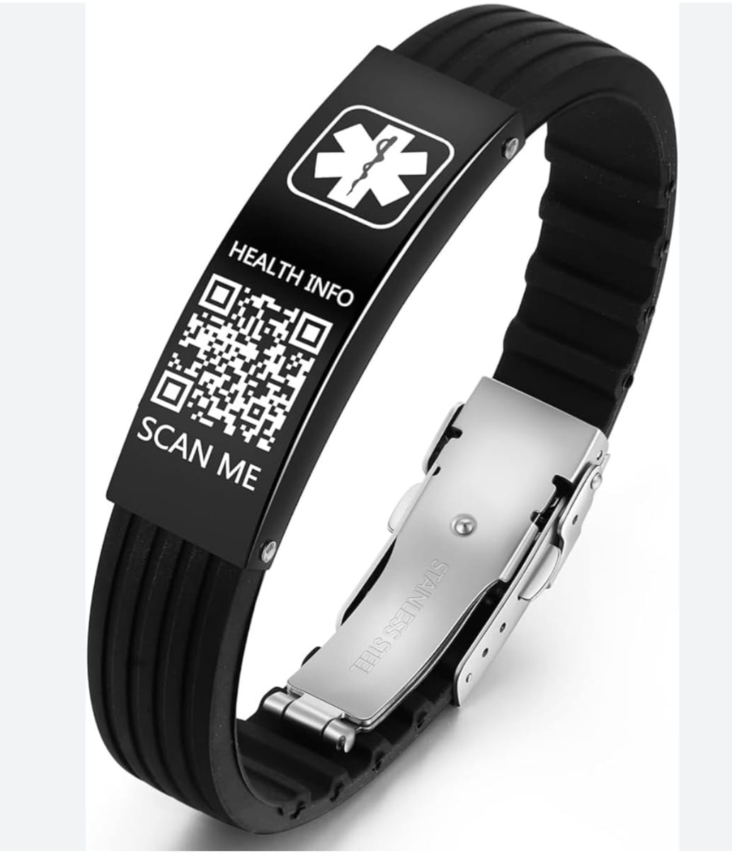
INTRODUCTION
Project Name: Med-Link
Objective: Med-Link is a medical solution that combines a discrete, customizable ID bracelet with a QR code linking to a secure user-managed medical profile. The goal is to provide critical medical info in emergencies while respecting user’s privacy.

Slide 3
PROBLEM STATEMENT
In an emergency, the first 60 minutes-often called the “Golden Hour”- are the most critical for survival and recovery.
Every year, millions of people are treated by emergency responders who have to make split-second decisions without knowing their patient’s allergies, chronic conditions, or current medications.
This often caused by;
Limited access to medical info in emergencies: People often can’t communicate their medical history or allergies in emergency situation.
Delayed treatment due to lack of info: Emergency responders may not have critical medical info leading to delayed or incorrect treatment
Inadequate medical systems: Current medical ID systems are often in adequate, inaccessible or not updated.

Slide 4
SOLUTON OVERVIEW
Med-Link solves this problems by:
Providing a secure, accessible medical profile.
Respecting user privacy with a QR code requiring scan access.
Allowing users to update info easily via the Web-App.

Slide 5
BUSINESS MODEL
B2c users manage profiles via the Med-Link Web-App, purchasing the physical ID bracelets.
Partnerships: Collaborate with healthcare providers, insurance companies, and employers for bulk orders or integrated services.
Subscription: Offer premium features or data management services for a recurring fee.

Slide 6
TARGET AUDIENCE
Health conscious individuals.
Families with vulnerable members (elderly, children with conditions.)
Healthcare providers seeking to improve emergency response.
Employers or insurances looking to support employee/ policy holder health.

Slide 7
THANK YOU

